Slide 1
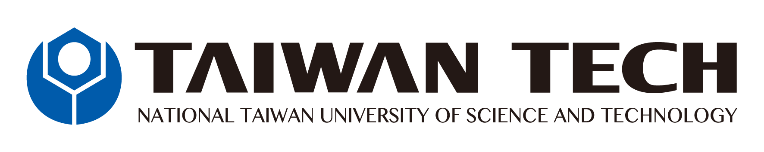
Blockchain in gaming industry
Jirayu Petchhan D10907801
Supitchar Tatiyathavornkul M10918803
Tanaporn Chaivutitorn M10921817
1
Notes:
As we know that nowadays the game industry is growing faster and faster including the welfare and safety of digitized assets such as in-game property. Currently, it becomes the role play of financialization and substantial community in the present.
The frontier of blockchain and decentralized systems into the games industry and realize the importance of every property for the in-game asset holder. This concept of novel application of in-game handling assets is the solution of the security to guard all of the property and digital welfare, for instance in-game money, renown, and popular items to prevent a non-friendly situation will occur such as hacking and spoofing. This system can ensure aspects of transparency, cumbersome with human intervention in property, truthless, and auditability.

Slide 2
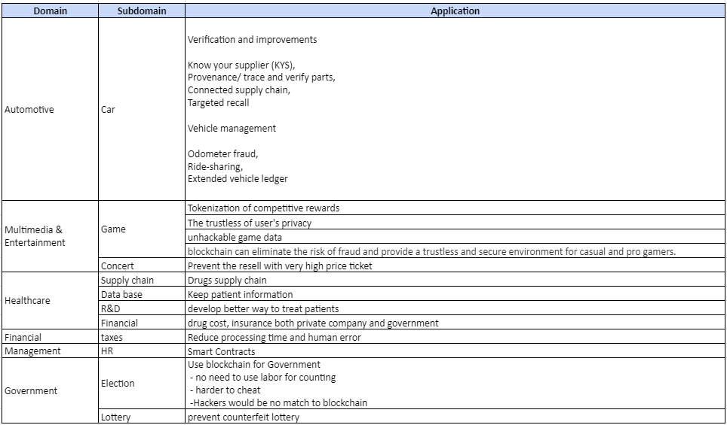
Application of Blockchain in difference field
2
Notes:
Blockchain has several applications which can be used in different industries. First, cryptocurrency exchange, in the financial field, blockchain enhances security of transactions which can get rid of single point failure and transfer agents. Second, secure sharing information, as used in the healthcare industry. For example, blockchain can facilitate the secure transfer of patient medical records, increase security, privacy, interoperability of health data, manage drugs supply chain, improve research and development process of new drugs or diseases. Third, the voting mechanism used by the government. Using blockchain in voting can enhance transparency, security, fraud prevention and auditability while voters still can keep their privacy. Lastly, an anti-money laundering tracking system. Since blockchain is an immutable ledger for regulatory oversight, it uses a decentralized network which every node needs to verify changes, making it incredibly secure.

Slide 3
The introduction and issue of blockchain in game industry.
The origin and importance
The gaming industry and electronics sports are growing faster and faster
The gaming industry was valued at $162.32 billion in 2020 and expected to reach $300 billion over the next five years (TransPerfect Gaming Team)
The actuality of various issues
Rely on centralized the development of games and multimedia
The fraud of prize in the tournament and/or competitive conference
The counterfeit of personal information
The fake game item
3
Notes:
Although many industries have applied blockchain technology to improve their reliability, the gaming industry still has room for implementation. We focus on the gaming industry because it outperformed by showing the biggest moneymaker in the entertainment industry. According to the TransPerfect Gaming Team, the gaming industry was valued at $162.32 billion in 2020 and expected to reach $300 billion over the next five years. However, The gaming industry nowadays still have some issues such as rely on centralized the development of game and multimedia for example ubisoft or steam. It requires a leader’s review and confirmation before releasing the game. In addition, for gaming competitive tournaments, players can cheat or counterfeit of person information.
The most important issue is the fraud in-game service, the user can form the invalid and unauthorized items and use them in the game. Therefore, the fraud item issue is not completely solved. We proposed a novel application using blockchain to solve the fraud problem in the gaming industry.

Slide 4
The novel approach
The proposed method roughly
Decentralized game development and assessment for launching
Loyalty and incentive schemes
Apply with e-sport tournament to become more transparency
Everyone accept the authentic of item
4
Notes:
So as the comprehensive and existing approach propose to apply with blockchain technology
we offer the novel approach to integrate in the gaming and multimedia industry as we know it is growing up faster and faster.
we propose the problem to support our approach i.e.
the gaming and multimedia development it still rely on the centralized system for example ubisoft or steam. it require a leader’s review and confirmation is still required before releasing the game.
In addition, for gaming competitive tournament, players can cheat or counterfeit of person information
The last issue is that in-game service, the user can form the invalid and unauthorized items and use in the game.
------------------------------------------------------------------------------------------------------------------------------------------------------------------------
so, our approach is proposed for Developing and evaluating the game through the assessments by everyone and the people who participates will receives an incentive for example, likes a non-fungible token or in-game-currency in advance when joining in the future
For the tournament issue, by using blockchain it will be more transparency
Reliable system for organizing game events In which everyone who attended the event, the audience of the contestants together to confirm the winner will receive the prize.
moreover, In the service of the game People will help to insist in the case of interpersonal exchange to prevent item counterfeiting.

Slide 5
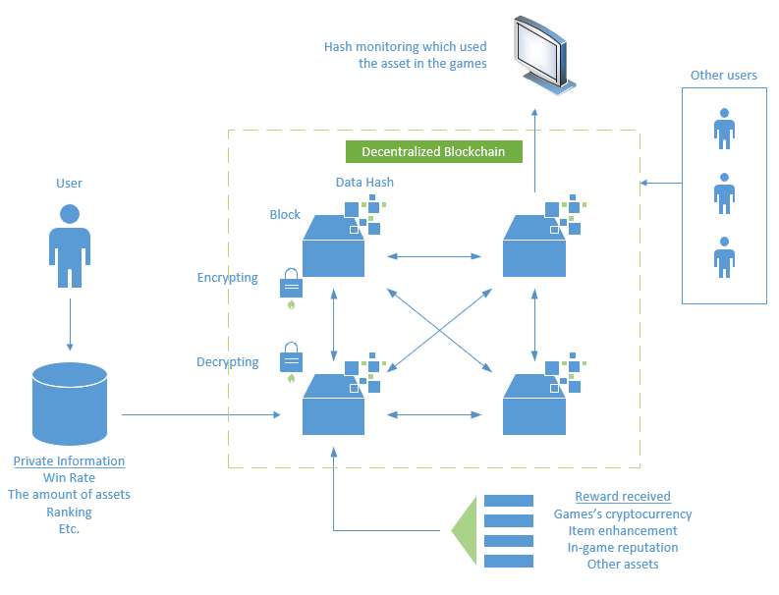
The proposed application
The proposed application consist of
handling property and personal information of users, such as number of assets, ranking, win rate and so on.
To encrypt data stored by hash block as a hash data.
The data can be monitored to verify the existence of the property and then be used to display it in the games.
The trading between two owners of their assets need everyone to agree.
Owing to the digitized asset run on blockchain, the illegal process (i.e., hacking an item, spawning the illegal things) is impossible.
5
Notes:
By our novel approach as the proposed application
by our approach the asset have been represented as the digitized in-game property i.e., the item, ranking of character, win/lose ratio, and so on
have been encrypted in the form of hash data contained into hash block of decentralized blockchain.
By the data hashed can be represented and displayed in-game to prevent anomaly person from stealing or transferring the property or belongings of the owners.
By the trading system is the same as realism asset of cryptocurrency exchanging and everyone in this case mean every block have to confirm this trading is legal or illegal. That is effective to the storing because the illegal process is impossible to occur.

Slide 6
The proposed application
Pros.
The advantage of proposed application
The trading system become trustless
The hassle of cheating (e.g. spawning the items via illegal method)
All digitized property can be realism asset in the day.
Cons.
The risk and/or limitation of establishing application
The trading process might be troubling to the owner and developer to support the user if the wrong transfer and/or transaction definitely occurs.
The impermanent loss of a welfare in the digitized asset.
6
Notes:
Pros.
So, as our proposed application
The advantage of the novel architecture as our think
For example, the trading will be trustless and more secure to owner each block
That is effective to unable cheating or counterfeit to the block with third parties program or from outside the system.
Moreover, this realism asset able to spend and exchange like real money.
----
Cons
But, there are some gap or limitation as we still see
such as if the process of transferring or trading have mistake between a couple agrees between 2 owner of blocks
Causing developers to have to deal with the problem of the loss of property.
And the uncertainty of this digitized asset can affect to the impermanent loss of property
If the game is saturation point As a result, the value is still ok or not? If the developer is unable to fork anything useful, the property can stay useful This asset is exposed to long-term use risk.

Slide 7
Thank you for your attentions

